Slide 1
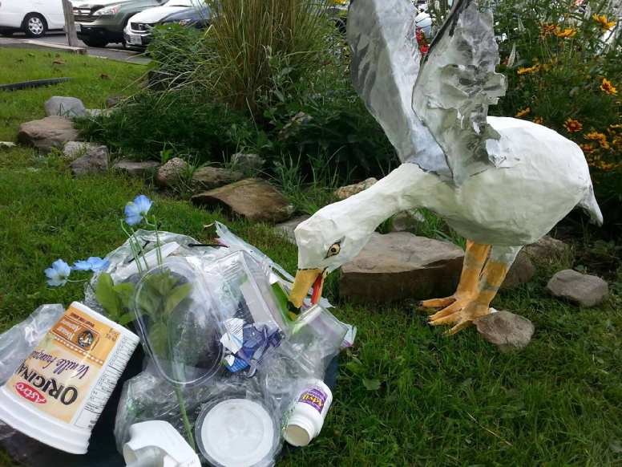
Neighbours in Ottawa South
Living in Alta Vista, Gloucester-Southgate and River wards
Inspire and support people in our area to take environmental action.
Thinking globally while acting locally
Come and join us!
It’s more fun together

Slide 2
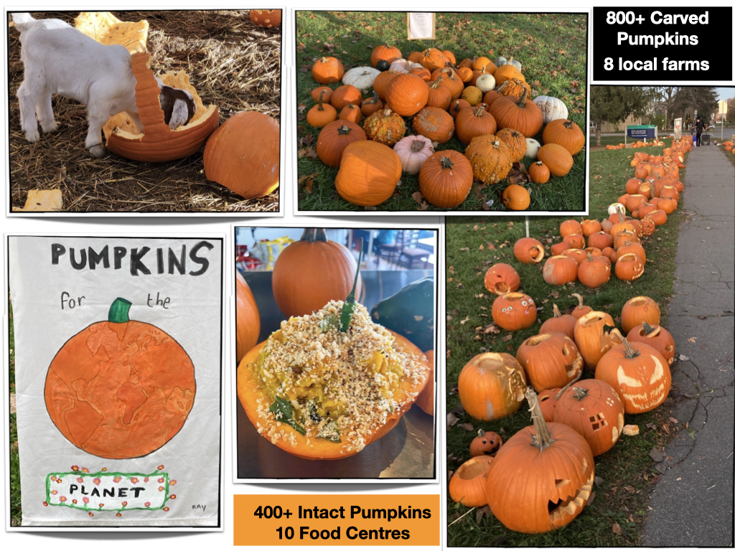
Pumpkins for the Planet
Pumpkins for the Planet
From the comfort of your home:
Email volunteers, food organizations farms
Be a collection point
Hand out flyers to trick or treaters!
Social media outreach
Graphic design
2023 will be our FIFTH year!
Planning starts now!
In the fresh air:
Redistribute pumpkins
Direct volunteers
Pumpkin lifting
Pumpkin drivers
Collaborations

Slide 3
Heat Pump Education
New
Hope to encourage more people to switch to a heat pump (to replace aging A/C or Furnace)
Share personal stories of neighbours who have heat pumps (blog/video, interviews)
Develop a website with details specific to Ottawa:
Heat Pump Retailers, Types of Heat Pumps available
Rebate programs ($6500 rebate in 2023!)
Links to videos and other resources
“Jane’s Walk” to visit a “electrified” house: solar panels, heat pump, electric vehicle
Support/encourage landlords and building owners to convert to Heat Pumps

Slide 4
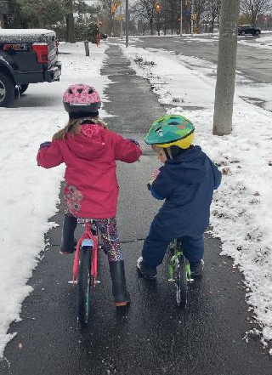
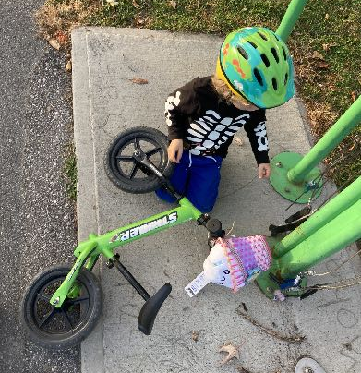
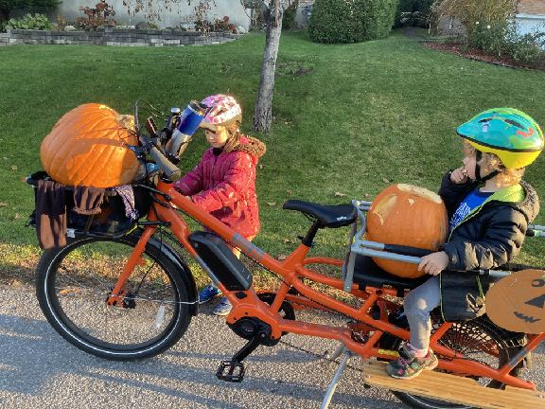
Bicycling Advocacy
New
Hope to encourage more people to trying biking
Provide opportunities for a simple bike tune-up
Organize a bike meet-up (try e-bikes, cargo bikes etc)
Share stories about neighbours biking
Advocate for safer bike infrastructure and connected pathways
Dream Big goals (volunteer!)
- Organize a group bike ride,
- Find “bicycle buddies” who can bike with you
Organize a bike share (e-bikes or cargo bikes)
Work with schools to expand “walk/biking school bus”

Slide 5
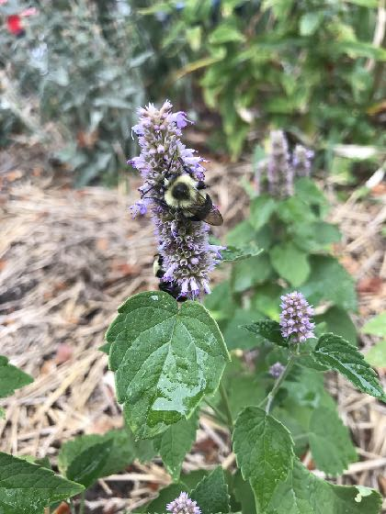
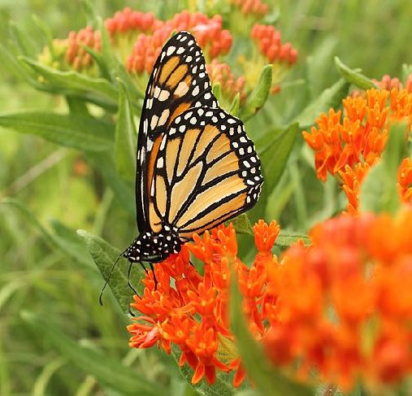
Naturalized Gardens
Build Pollinator Habitat:
Inspire and Encourage people to plant more native species
Free Native seeds
Free (or inexpensive) Native seedlings
Education (our website) and resources
Advocate for updated bylaws
- Yard Signs (Educate and normalize Front Yard Gardens)
Collaboration: Ottawa Wildflower Seed Library
Volunteer!
Looking for “Seed Sitters”
- Grow native plants from seed
- “Babysit” seedlings

Slide 6
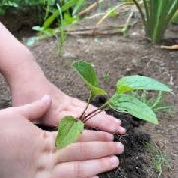
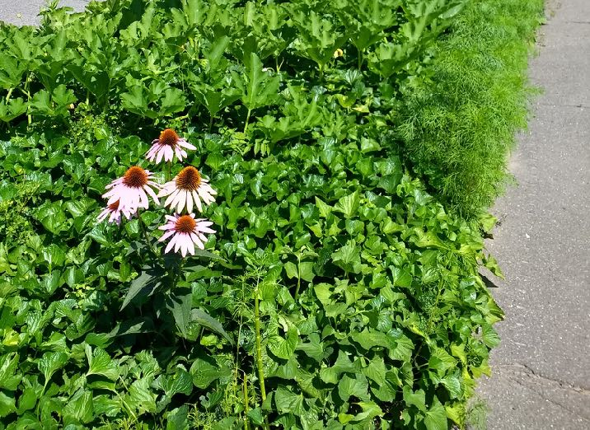
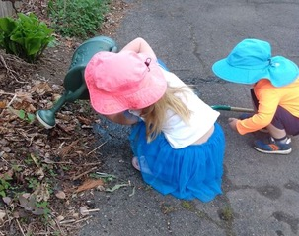
COLLABORATIONS
Naturalizing Ottawa’s Boulevards & Right of Way
DYK: Ottawa currently does not allow changes (including gardening) to the City’s Right-of-Way green spaces?
Naturalized Right of Way
✅ Protect Biodiversity ✅ Sequester Carbon
✅ Protect stormwater infrastructure
✅ Increases equity by ⬆️ access to green space ✅ More regional cooling
City Council AGREED in MAY 2022 To Amend
City Staff Currently Working on DRAFT BYLAW
Report and Draft BYLAW expected in Q2 (APRIL-JUNE)

Slide 7
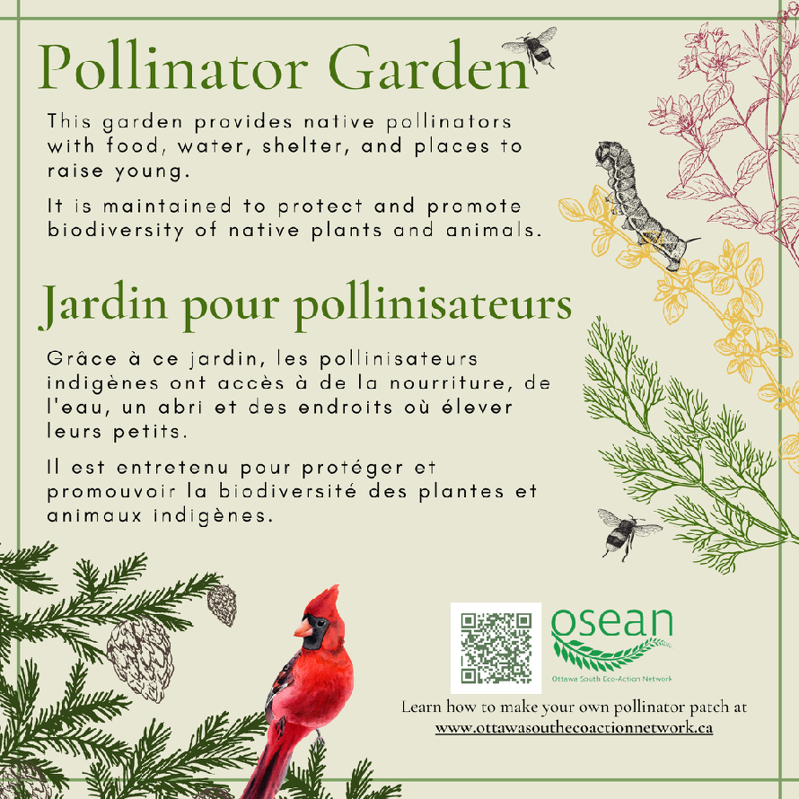
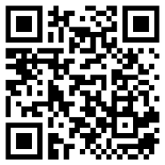
YARD SIGNS
Show your neighbours that your lawn or balcony is intentionally designed to help our native pollinator and bird populations.
Purchase a yard sign kit to help OSEAN fundraise and transform Ottawa South into a network of pollinator patches to increase biodiversity
Each kit includes:
* Repurposed Chloroplast Sign
* Pollinator Garden Decal
* Sign Post
Fill in our Google Form so we can contact you when we are ready for our first order
Additional Signs in Development:
Leave the Leaves
Know Maintenance May

Slide 8
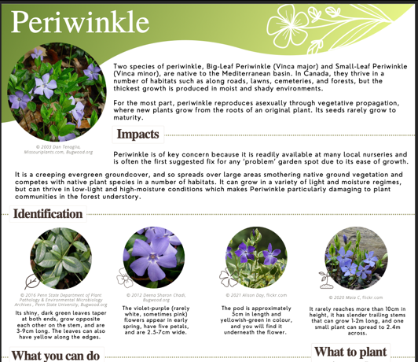
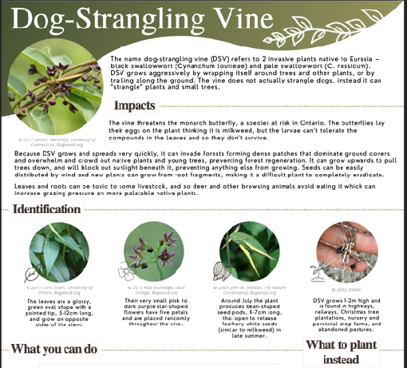
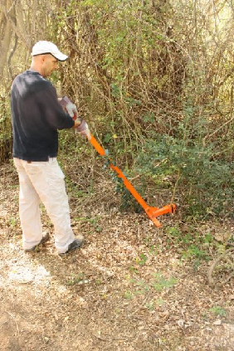
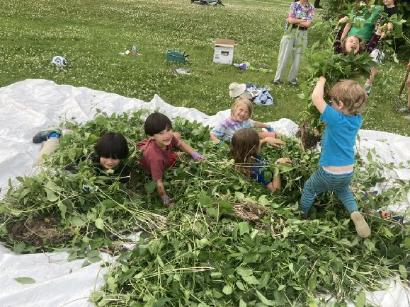
Invasive Plants
Protect Biodiversity by Removing Invasive Plants
Educate and Empower Neighbours
What OSEAN did in 2022?
- Invasive Species 101 Webinar
- Three in-person “weeding bees”
- Created a Weed Kit to Borrow
What you can do (Volunteer)?
Learn about the problem and how to Identify
Remove them from your Yard (Borrow our Weed Kit)
Attend our weeding bees to remove them from public spaces
(Permission/Right to Access is Required)
https://ottawasouthecoactionnetwork.ca/activities/invasive-species-program/

Slide 9
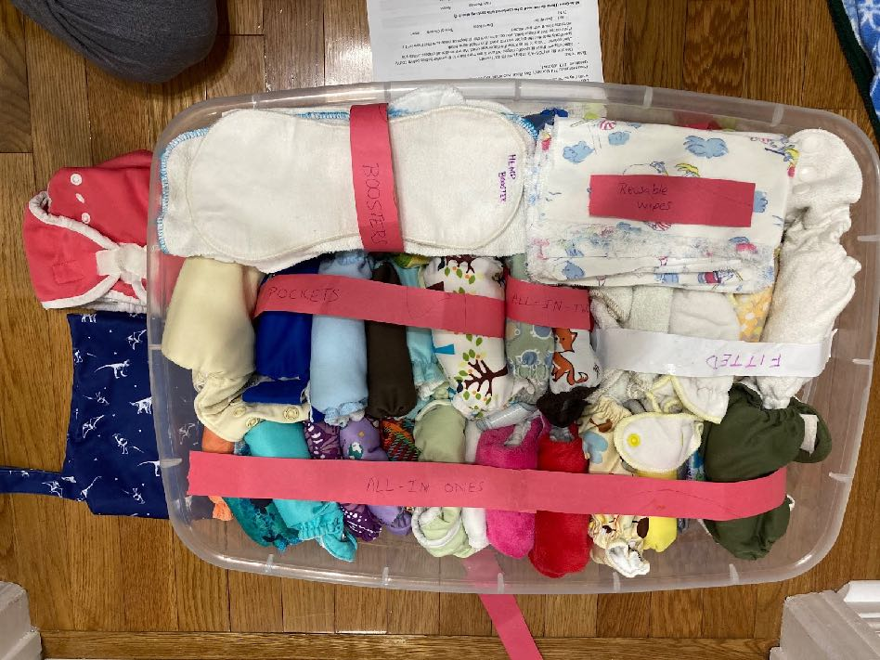
Cloth Diaper Trial
Remove Barriers for Families to try Cloth Diapers and Educate
- Three week cloth diaper Trial
- Try a variety of styles and brands
- Introductory Video and “cheat sheets”
- Ongoing troubleshooting and support
Three “newborn” kits (<12 lbs)
Three: 2-18 month kits
Toddler Kit
Overnight Diapers Kit
Volunteer!
Administrative (email - new family registration) (~1 hr/wk)
Help with sanitizing diapers (1 once/month)

Slide 10
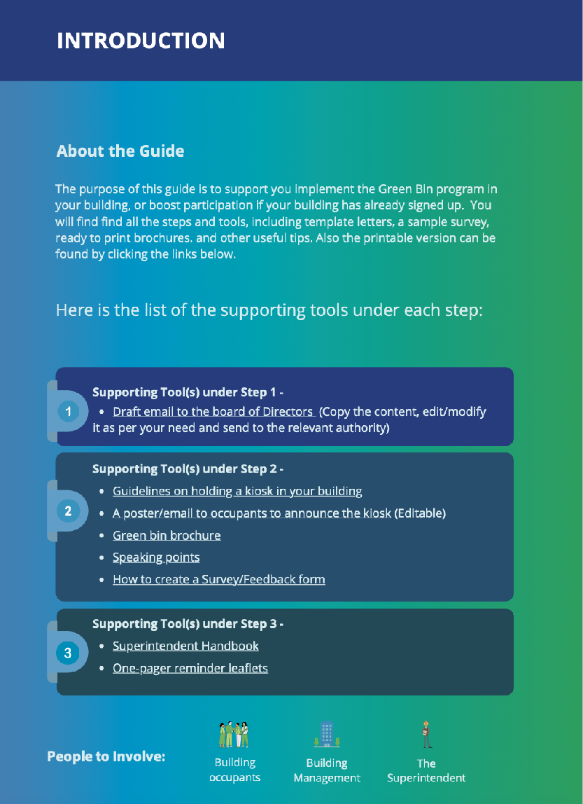
Collaborations
WORKING TO INTRODUCE THE GREEN BIN COMPOSTING INTO MULTIUSER DWELLINGS
https://www.gentlewaysforourplanet.org/step-by-step-guide-to-promote-the-green-bin-program-in-your-building/

Slide 11
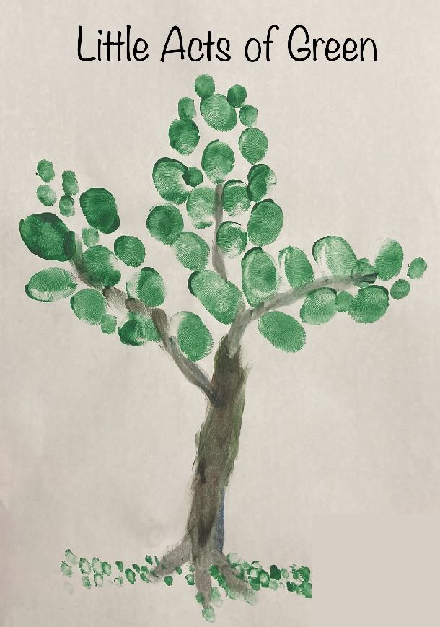
Join us in making Ottawa South Greener and more Sustainable Small ripples can make waves
Lots of opportunities and ways to volunteer
“Table” at an Event (Increases our presence/reach
Help us with a simple project (e.g plastic recycling at metro!)
Be a “seed sitter” (grow more native plants)
Put up a yard sign
Send one of our letter(s) to an elected official
Help us promote events
Wordpress - Website support (once a month update)
Share our posts on twitter/instagram/Facebook
Help us with Instagram/Twitter
Come to an Invasive Plant Weeding Bee!
Sanitize Diapers or help with administration (emails)
Send us an email: osean.info@gmail.com

Slide 12
