Slide 1
McCarthy Road Curve – Safety Improvements
Cathy Kourouma, Traffic Services 03 June 2024

Slide 2
Collision Data – McCarthy Road Between Southmore Drive & Plante Drive
January 1, 2015 to December 31, 2019:
Total Collisions = 7
Rear End Collisions = 1 (southbound)
Approaching Collisions = 3 (northbound/southbound)
Single Motor Vehicle Collisions = 3 (northbound)
Note: Unreported collisions/incidents are not captured in this data. Additional occurrences of vehicles leaving the roadway have been reported by members of the public.

Slide 3
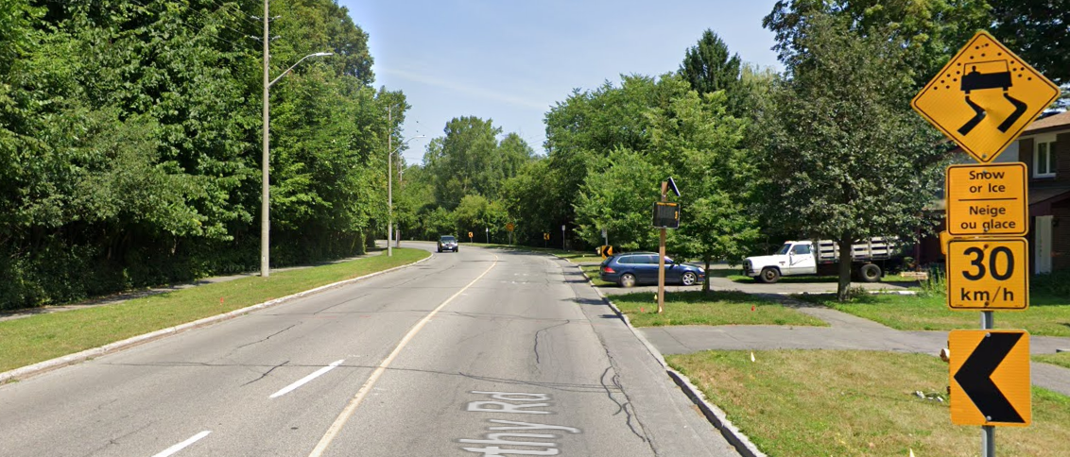
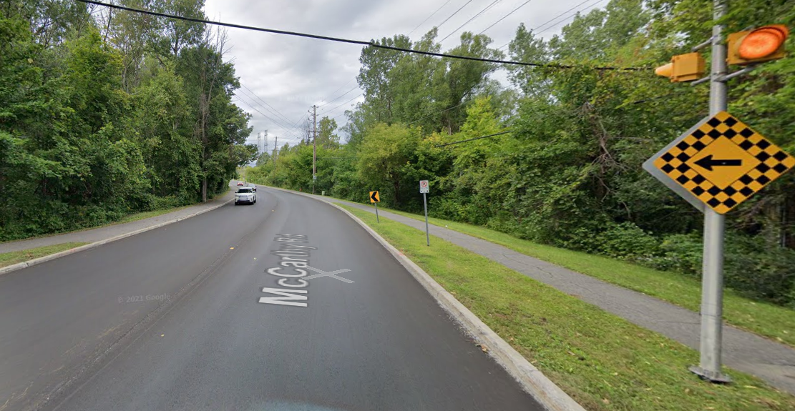
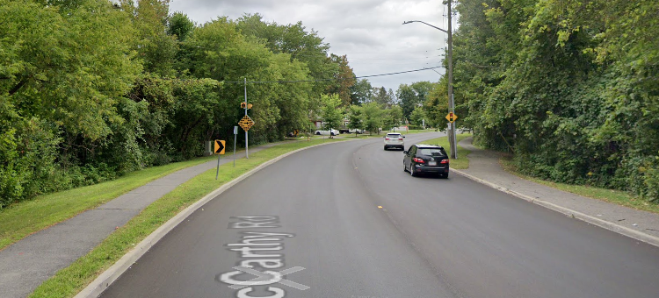
Existing Safety Measures
McCarthy Rd., looking north
Chevron warning signs to indicate change in roadway alignment
Advisory speed warning signs
Flashing beacons to warn drivers of upcoming curve
Speed display board
High Friction Asphalt (2019)
McCarthy Rd., looking north
McCarthy Rd., looking south

Slide 4
Safety Review
Independent, high-level evaluation of curved section of McCarthy Rd. to mitigate risk of northbound vehicles leaving the roadway and encroaching on the eastern sidewalk
2 options reviewed:
1) Installation of guiderail
2) Horizontal measures – pavement markings, concrete medians or pre-cast curbs

Slide 5
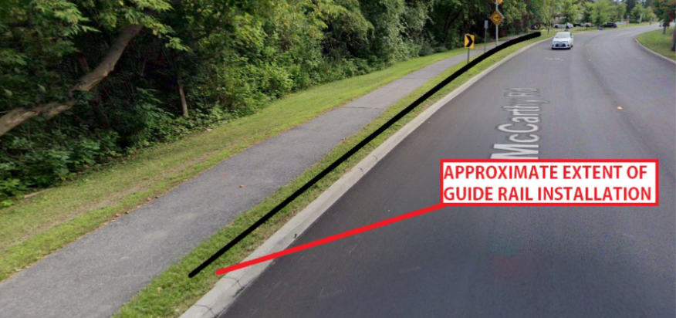
Option 1 – Guiderail
Guiderails are meant to deflect and redirect vehicles in the event of a collision
Clearance is required between the guiderail and edge of sidewalk

Slide 6
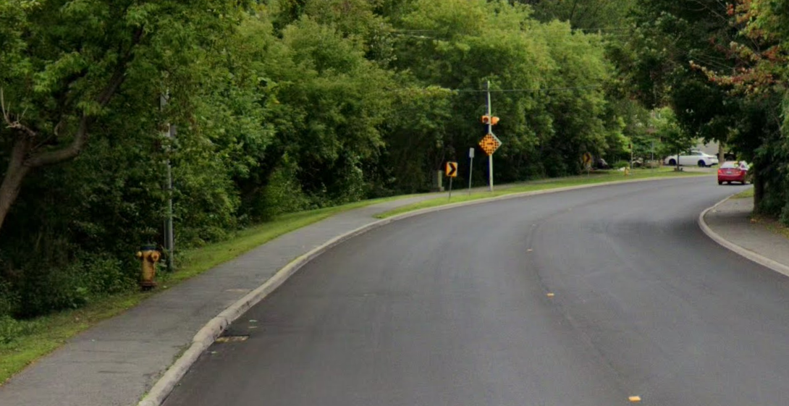
Option 1 – Guiderail Con’t
Area at the end of grass would remain unprotected.
To install guiderail extensive sidewalk modifications would be required to meet design guidelines and accessibility requirements.

Slide 7
Option 2 – Horizontal Measures to Reduce Vehicle Speeds
Lane widths have been shown to be an important factor in vehicle speeds.
Wide lanes encourage greater speeds on approach to the curve.
Recommendation to reduce the lane widths on approach to the curve.
Horizontal measures such as pavement markings and lane narrowing's considered as potential traffic calming measures.

Slide 8
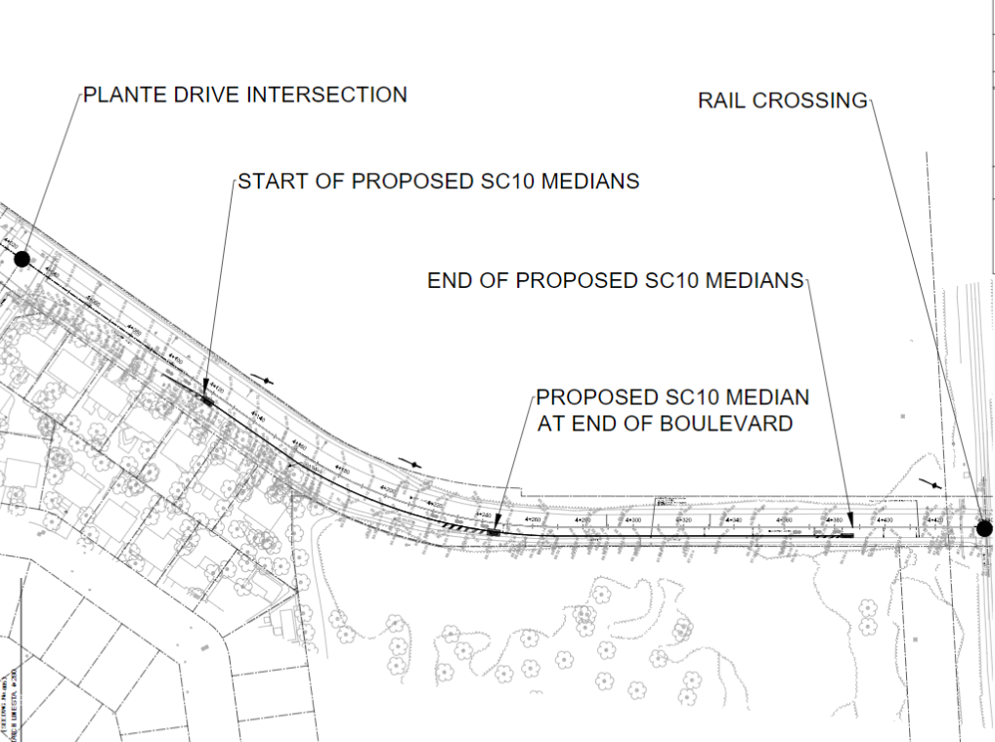
Option 2 – Horizontal Measures to Reduce Vehicle Speeds Con’t
Draft Proposed Safety Measures:

Slide 9
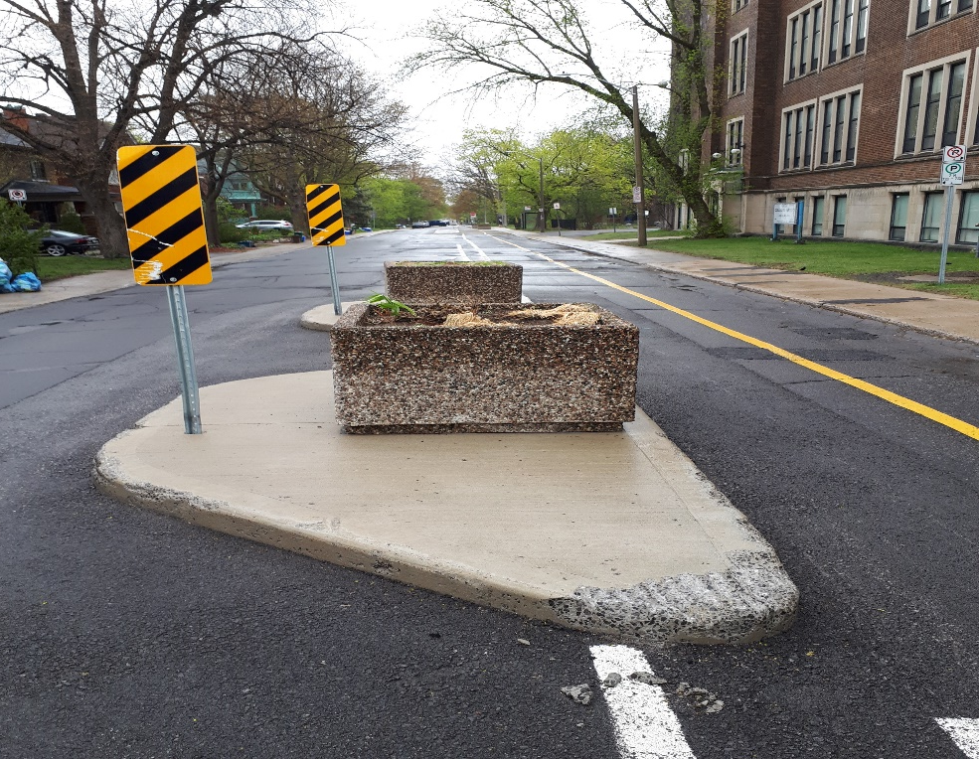
Option 2 – Horizontal Measures to Reduce Vehicle Speeds Con’t
Proposed Safety Measures:
Sample of concrete median (Note: Planters would not be installed on McCarthy Rd.

Slide 10
Questions?

